Slide 2
Some locations have multiple tax authorities
Taxes are due, yearly, biannually, quarterly, or on some payment arrangements monthly
Send in funds for taxes 30 day prior to payment due date.
If you pay your own taxes please advise your servicer and provide them a receipt
Be aware that some locations apply delinquent utilities to taxes.

Slide 3
Current accounts must have taxes paid in order to stay in compliance with Federal Regulation.
If taxes are due and funds are not available in escrow taxes will be paid and investor funds will be needed
Escrow payments that bring escrow back up to a zero dollar balance are reimbursed to the investor
Positive escrow funds belong to the borrower
Always provide tax bills you have received to your servicer

Slide 4
Understanding Escrow

Slide 5
What can escrowed
Taxes
Insurance
Utilities
Ground Rents
Escrow Analysis
Regulation does not require analysis be performed on delinquent accounts
Escrow analysis is performed annually.
Analysis is completed the month of the first payment date & if a severe deficiency or shortage is found when paying taxes
Analysis letter is sent to borrowers

Slide 6
Surplus, Shortages, & Deficiencies
Shortages occur when funds are available in escrow but the aren’t sufficient to cover upcoming expenses
Deficiency indicates a negative balance in escrow.
You both owe funds for previous shortages & aren’t projected to have sufficient funds for upcoming taxes
Surplus of escrow is issued to the borrower as a refund, but can if requested by the borrower be applied to principal or payments
Delinquent borrowers cannot be issued a refund, but may have the option to apply surplus funds to the delinquency

Slide 7
Taxes & AMX

Slide 8
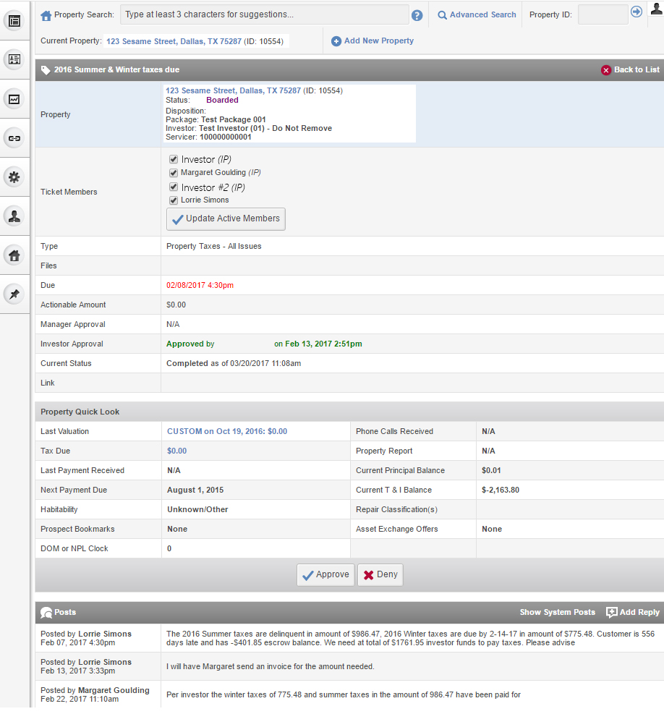
If escrow is not available for tax payment an action ticket is opened requesting approval for tax payment
Approve or Deny taxes within AMX action tickets.
Add questions or information relating to taxes to tickets in AMX.

Slide 9
Add questions or information relating to taxes to tickets in AMX.

Slide 10
Delinquent Taxes

Slide 11
Penalties and Property Loss
Penalties Continue to Accrue on Delinquent Taxes
Avoid Tax Sales Unless Accepting Strategic Risk
Delinquent Taxes Can Require Payment of All Taxes
Redemption Can Require Payment of All Liens and Taxes
Delinquent Taxes May Draw Negative Attention from Counties

